Slide 1
The Harlem Hellfighters
Unit 2A

Slide 2
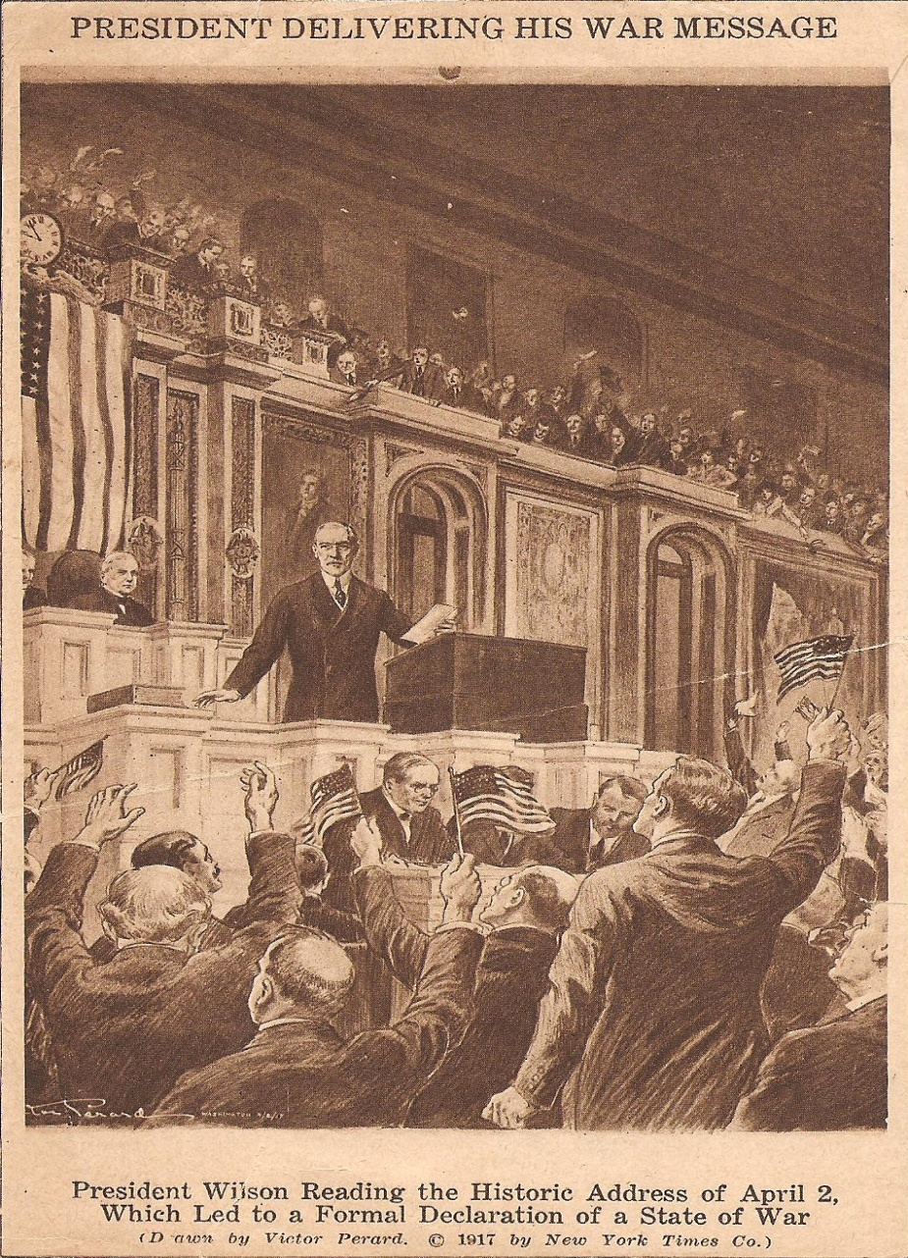
America enters the war.
April 2, 1917, President Wilson asked Congress to declare war on Germany. "The world," he said, "must be made safe for democracy.“
Quickly, Americans swung into action to raise, equip, and ship the American Expeditionary Force to the trenches of Europe.

Slide 3
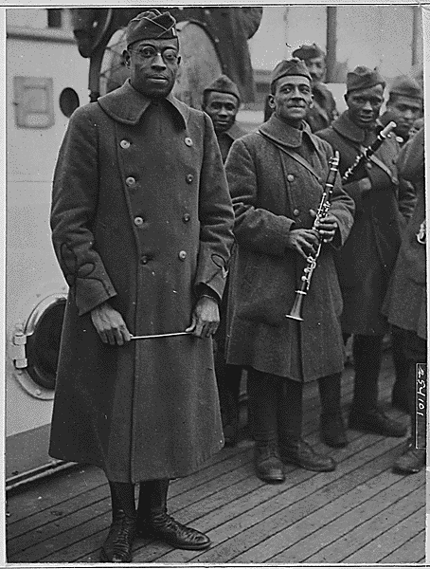
Harlem Hellfighters
Among the first regiments to arrive in France, and among the most highly decorated when it returned, was the 369th, the "Harlem Hellfighters."
The 369th was an all-black regiment under the command of mostly white officers including their commander, Colonel William Hayward.

Slide 4
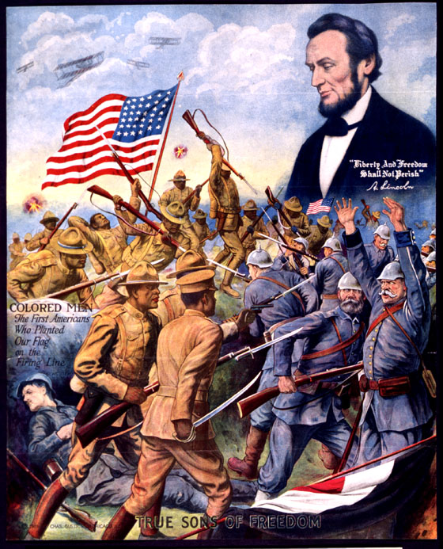

Slide 5
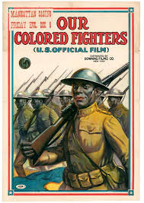

Slide 6
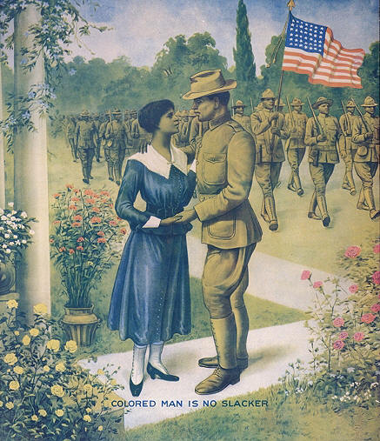

Slide 7
Equality in service?
Participation in the war effort was problematic for African Americans.
Plessy v. Ferguson (1896) established that the 14th Amendment allowed for separate but equal treatment under the law.
The U.S. Army at this time drafted both black and white men, but they served in segregated units.
After the black community organized protests, the Army finally agreed to train African American officers but it never put them in command of white troops.

Slide 8
During World War I 380,000 African Americans served in the wartime Army.
Approximately 200,000 of these were sent to Europe.
More than half of those sent abroad were assigned to labor and stevedore battalions, but they performed essential duties nonetheless, building roads, bridges, and trenches in support of the front-line battles.
Roughly 42,000 saw combat.

Slide 9
The Hellfighters in France
The 369th Infantry helped to repel the German offensive and to launch a counteroffensive.
With the French, the Harlem Hellfighters fought at Chateau-Thierry and Belleau Wood.
They spent 191 days in combat, longer than any other American unit in the war.
"My men never retire, they go forward or they die," said Colonel Hayward. Indeed, the 369th was the first Allied unit to reach the Rhine.

Slide 10
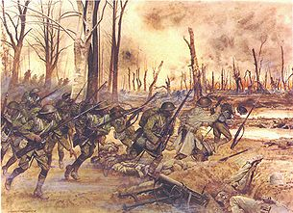

Slide 11
Honour for the Hellfighters
The extraordinary valor of the 369th earned them fame in Europe and America.
Newspapers headlined the feats of Corporal Henry Johnson and Private Needham Roberts.
In May 1918 they were defending an isolated lookout post on the Western Front, when they were attacked by a German unit. Though wounded, they refused to surrender, fighting on with whatever weapons were at hand.
They were the first Americans awarded the Croix de Guerre, and they were not the only Harlem Hellfighters to win awards; 171 of its officers and men received individual medals and the unit received a Croix de Guerre for taking Sechault.

Slide 12
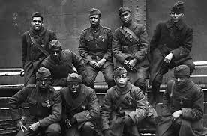

Slide 13
The return home
Upon departure they were not permitted to participate in the farewell parade of New York's National Guard, the so-called Rainbow division.
"black is not a color in the Rainbow.“
Granted a victory parade when they came home in February 1919.
Crowds thronged New York City's Fifth Avenue as the 369th marched to the music of their now- famous regimental jazz band leader, James Reese Europe.

Slide 14
Equality @ home?
On the political front, participation in World War I did little to directly advance the equal rights of African Americans.
It did heighten awareness of the gulf that existed between American rhetoric and reality.
"I want to congratulate you for doing your bit to make the world safe for democracy . . . and unsafe for hypocrisy.“ Philip Randolph

